Slide 1
Notes:
This presentation is for introducing the ICE CityZen Award to students before taking part in the 2024-25 competition.
It’s designed as a quick introduction only. We recommend that participating students should review the competition’s Student Guide for a full briefing. There are also further guides for the CityZen Game and the Project Pitch for students looking for more guidance and information.

Slide 2



CityZen Award – who are ICE?
A little bit about us…
The Institution of Civil Engineers (ICE) is a professional body that promotes and supports civil engineering. It’s where civil engineers come together to create solutions that enable our planet and our people to thrive.

Slide 3
CityZen Award – about the CityZen Award
What is the Award?
The ICE CityZen Award is a fun, rewarding and unforgettable journey. Plus, it could pave the way for a fulfilling career in civil engineering. There are two ways to get involved – just pick the one that works best for you!
The CityZen Challenge
The first stage is to play the award-winning CityZen game – four weeks of engrossing gaming with your friends.
Complete Project Pitch to enter the CityZen Award
To achieve the full Award, after the game, you can pitch a project to improve your area.

Slide 4
CityZen Award – why take part
Why take part? Here’s a few reasons…
Communication skills Build skills and confidence through teamwork and presentation challenges.
CityZen is a unique and enjoyable competition. It helped me to expand my communication and leadership skills.
Year 12 student Barton Peverill College
Employability Develop your collaboration, critical-thinking and ability to research – all ‘soft skills’ highly valued in the workplace.
Creativity CityZen encourages innovative thinking and problem-solving.
Leadership You can take charge, delegate tasks and inspire your peers.
Digital expertise Past participants have loved developing their digital skills to make videos for the Project Pitch.
Myth-busting inspiration CityZen has opened the door to more young people like you realising civil engineering could be a career for them.
Opportunities to shine Exercising new knowledge and skills gives confidence.

Slide 5
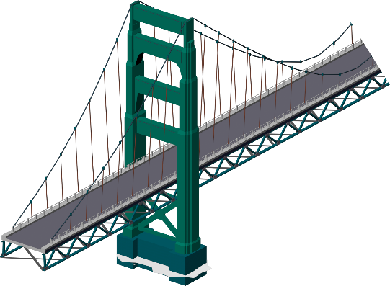

What is civil engineering?
First, let’s check we’re up to speed with what civil engineers do…
Civil engineers:
Build our houses, schools, hospitals and more
Deliver the transport that moves us around
Provide the water and energy that keeps us alive
Design the smart cities and towns where we'll live in the future
Tackle global environmental problems affecting us all

Slide 6
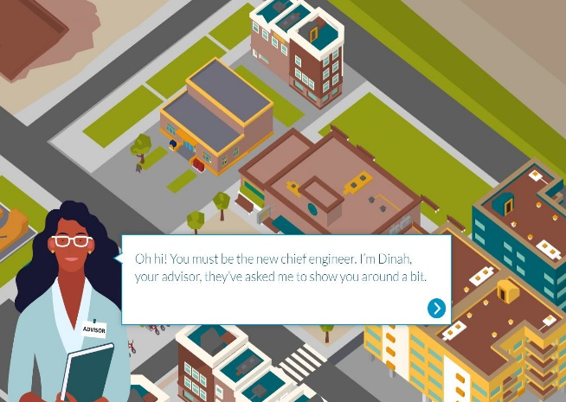
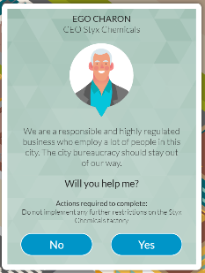
CityZen game – stages and tasks
The CityZen game is easy to understand; the game's advisor will tell you what you need to do.
First things first… research
Discover what needs to be done in the area
Find out key facts about the environment that will affect your choices
Warning! You’ll also be asked to make promises…consider these carefully.

Slide 7
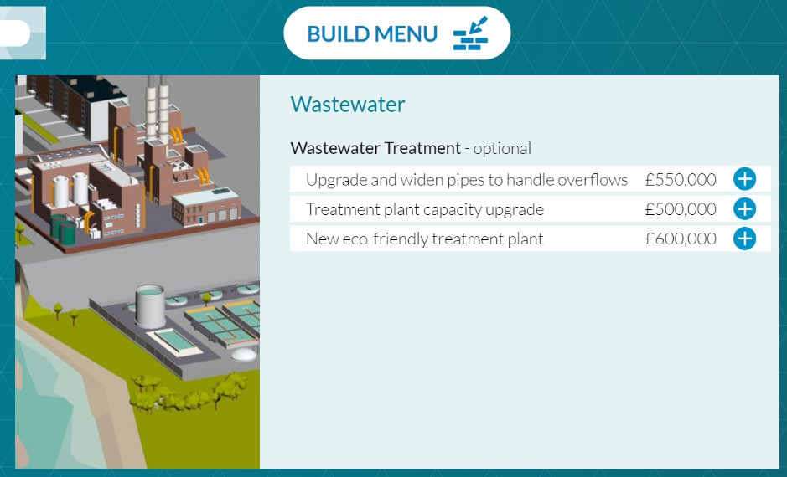
CityZen game – stages and tasks
Next - it’s time to build!
Choose options from the build menu
Don’t rush into decisions – you can’t undo them later!
Don’t forget! You made promises earlier in the game… not meeting these can impact your score.

Slide 8

CityZen Award – Project Pitch
What would you make better?
Project Pitch is your chance to be creative and show how much you’ve learnt.
Put yourself in a civil engineer’s shoes; come up with an idea for improving your local area and tell us how you’d do it.
Project Pitches need to be submitted in video form and between 2-4 minutes long, of up to 50MB in size and MP4 format.
Notes:
Photo by Uriel Mont from Pexels: https://www.pexels.com/photo/smiling-black-lady-with-tablet-in-street-near-building-6280728/

Slide 9


CityZen Award – scoring and prizes
CityZen is a game unlike any other…
It’s a learning game, where your game probably differs to your classmates’:
different people to help = different outcomes!
Complete the game - get a certificate of achievement
Top three scoring teams win vouchers of up to £50 per student
Submit a Project Pitch which demonstrates great learnings from the game, and you could win much more…
Notes:
*Needs a disclaimer

Slide 10


CityZen game – scores & prizes
Project Pitch … the Gold, Silver and Bronze Awards
The teams who submit the top three Project Pitches will win:
Cash prizes of up to £2,000 (shared equally between students and school).
A money-can’t-buy VIP trip including lunch at the Institution of Civil Engineers’ London headquarters!
Notes:
*Needs a disclaimer

Slide 11


CityZen game – more prizes
Special award for 2026
The additional award* for Project Pitches is:
JBA Trust Special Award for Nature and People Positive Innovation
For the most creative and practical way to support nature and the environment.
Prize: £500 – split equally between students and school.
This award winner will also be invited to the VIP visit to ICE’s London Headquarters with the Gold, Silver and Bronze winners.
*Additional awards are subject to change at ICE’s discretion
Notes:
*Needs a disclaimer

Slide 12


CityZen game – debrief
At the end of the game…
We hope you enjoyed our challenge!
Perhaps it’s raised a few questions, like…
Did you have enough money to do everything you wanted?
Which promises did you break… and did you figure out why?
What decisions would you make differently if you did it again?
What do you think you would enjoy about being a civil engineer?
Notes:
This slide is intended to facilitate a review of the game – to the share the game learnings and check understanding if you have time left in your session. It’s completely optional of course!

Slide 13
Have we built your interest in civil engineering?
Stay tuned for a quick low-down on the career’s top facts…
Notes:
Slides beyond this point could be shown if your school does not have a competition mentor who can give civil engineering career info.
You might look at them at the end of the first or fourth game session.

Slide 14

Could you be a civil engineer?
If you like designing or building, solving problems or improving lives then you’d enjoy a career in civil engineering.
Choosing the right subjects at school or college is important – maths is usually required and physics often too.
Notes:
To become a civil engineer you’ll need to choose the right subjects at school or college. It’s a good idea to check the requirements for any courses you’re interested in, as they can vary a lot.
Maths at A level or Scottish Highers is needed to get onto nearly all civil engineering degree courses. A good grade at GCSE or equivalent will help you secure an apprenticeship.
Physics at A level or Scottish Highers is also asked for by many universities.
Other useful subjects for civil engineering include Geography, Art and Design, Design Technology, Computing, English and some specialist courses such as the Design Engineer Construct! Programme which is offered in some schools.

Slide 15







Top career facts
The average (mean) starting salary is £28,000. Experienced civil engineers earn around £60,000 and at the top of the profession over £100,000.
It’s a career which has clear routes through study and qualification.
Studying to become an engineer can open doors to other careers: it keeps your options open!
The UK needs lots more civil engineers.
Civil engineers’ skills are in demand across the world.
Civil engineering regularly features in polls of the top happiest jobs!
Qualified engineers have a high status similar to doctors and lawyers.

Slide 16

How to become a civil engineer
There are loads of routes into civil engineering…
You could do A levels/Highers and then study at university.
You could get straight to work with an apprenticeship – combining study and hands-on experience.
OR you could do a vocational course… this might lead to an apprenticeship or university.
Notes:
Studying at university can give you a fast-track route to Chartered Engineer status and the top jobs in the profession. For more info see ice.org.uk/beacivilengineer
A vocational course (such as BTEC or HND) combines study with ‘hands on’ experience and can give you a fast-track to qualified Engineering Technician status. If you get taken on as an apprentice by a company you’ll get paid as well as be given time off each week to learn. It’s possible to progress from this role to become a Civil Engineer with enough job experience.
There are more ways to study and enter industry than ever before – including starting while still at school (foundation apprenticeships) and working and getting a degree at the same time (degree or graduate apprenticeships). For more info see ice.org.uk/apprentices

Slide 17

Real-life civil engineers
Let’s meet a civil engineer.
Hiba Khan studied at the University of Edinburgh and went on to work in international development.
Play the video to hear directly from her about how she helps people and planet.
Find more about her:
ice.org.uk/hiba-khan
Hiba Khan
Notes:
[Internet connection is required to play the linked video about civil engineer Hiba Khan.]
Hiba Khan is a Chartered Civil Engineer with Mott MacDonald who works on water engineering and flood alleviation.
Full profile at: https://www.ice.org.uk/what-is-civil-engineering/civil-engineer-profiles/hiba-khan

Slide 18


Explore and play in a future world of interactive civil engineering challenges.
ICE-futures.com
Final step 1 of 2…
Notes:
www.ice.org.uk

Slide 19


Free Virtual Work Experience ice.springpod.com
Final step 2 of 2…
Notes:
Virtual Work Experience is an online learning programme managed by award-winning education provider Springpod.
It is free and available to students aged 14-18 based in the UK.
Completing the programme gives a digital certificate and is a great addition to a CV or UCAS application.
https://bit.ly/ICE-virtworkexp

Slide 20

Thanks for taking part 🙂
Tell us what you thought for the chance to win a £20 Waterstones voucher: bit.ly/CZ26-student-survey
Notes:
https://bit.ly/feedback-pollution-challenge

