Slide 1
Notes:
You can use this slide show to introduce the Pollution Control Challenge Competition to a group of young people aged 14-16.
At the end of your session you might also want to hand out printed careers guides following your session (order copies free online from https://bit.ly/ICE-11-16-careers-guide).
Please get in touch with any queries or comments at careers@ice.org.uk

Slide 2





What is civil engineering?
Welcome to the ICE CityZen Pollution Control activity from the Institution of Civil Engineers.
First, let’s check you know what a civil engineer does…
Civil engineers:
Build our houses, schools, hospitals and more
Deliver the transport that moves us around
Provide the water and energy that keeps us alive
Design the smart cities and towns where we'll live in the future
Tackle global environmental problems affecting us all

Slide 3

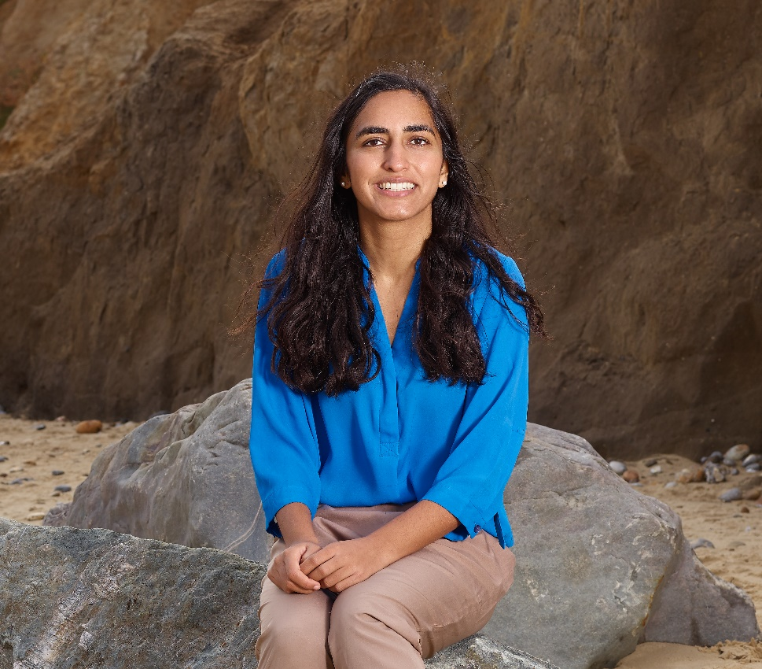

Real-life civil engineers
Let’s meet a civil engineer who works in water management before you step into their shoes.
Play the video to hear directly from Hiba about how she helps people and planet.
Find more about her:
ice.org.uk/hiba-khan
Hiba Khan
Notes:
[Internet connection is required to play the linked video about civil engineer Hiba Khan.]
Hiba Khan is a Chartered Civil Engineer with Mott MacDonald who works on water engineering and flood alleviation.
Full profile at: https://www.ice.org.uk/what-is-civil-engineering/civil-engineer-profiles/hiba-khan

Slide 4

Pollution Control game
In our game, you’re a detective civil engineer…
Just who
or what
is polluting
the river?!

Slide 5
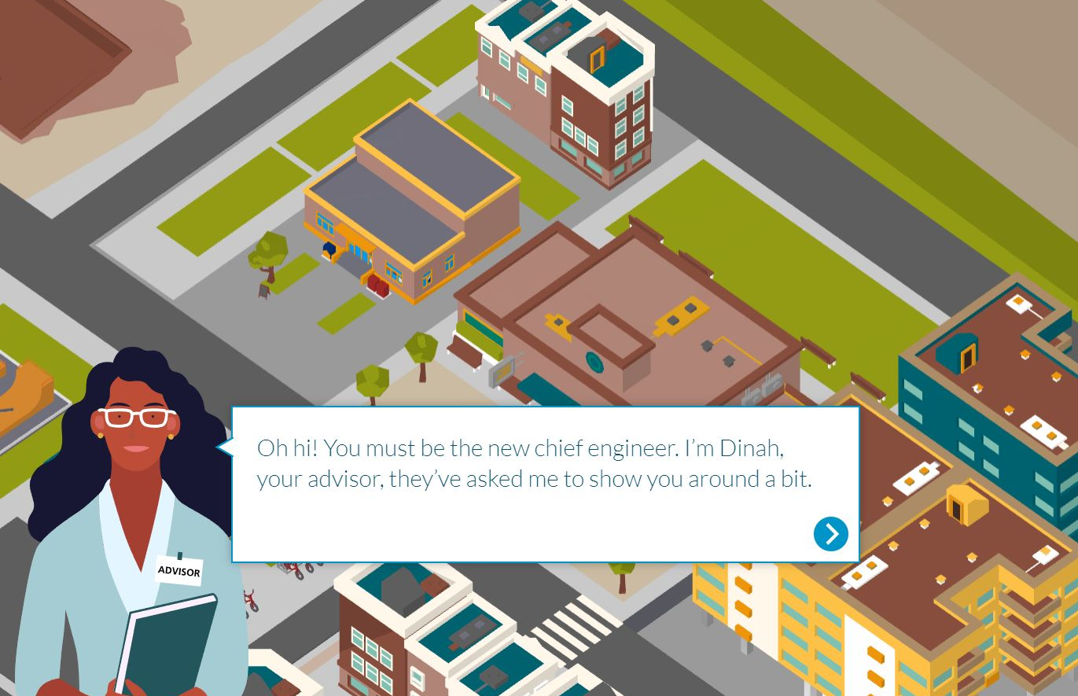
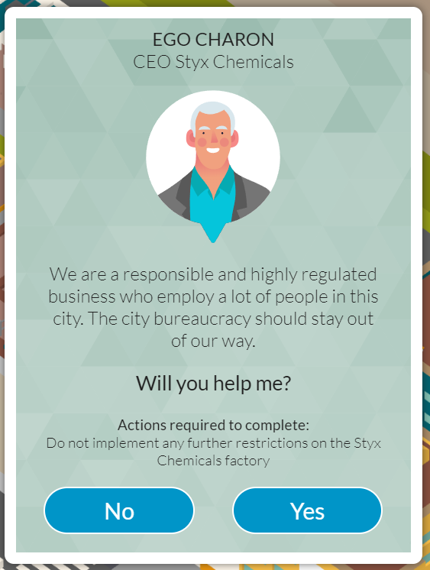
Pollution Control game – stage 1 research
Stage 1: Research
Find out key facts about the environment
Discover the possible sources of pollution
Warning! You’ll also be asked to make promises…consider these carefully.

Slide 6
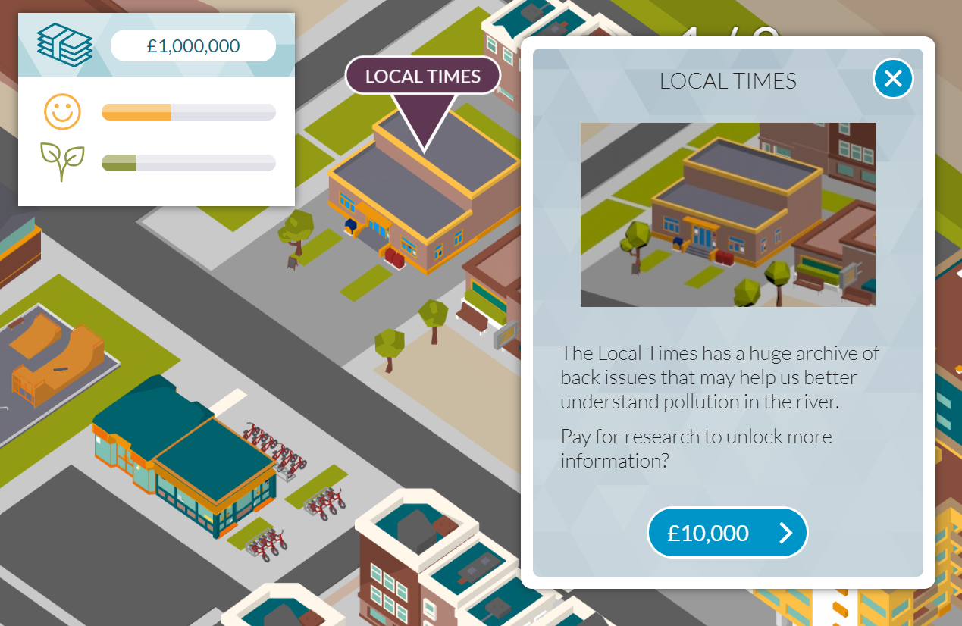
Pollution Control game – stage 2 analysis
Stage 2: Analyse
Recap on the info you’ve gathered
Examine the causes and decide which issues to tackle
Pro tip: write short notes as you go about things that seem important.. so that you don’t forget when you build.

Slide 7
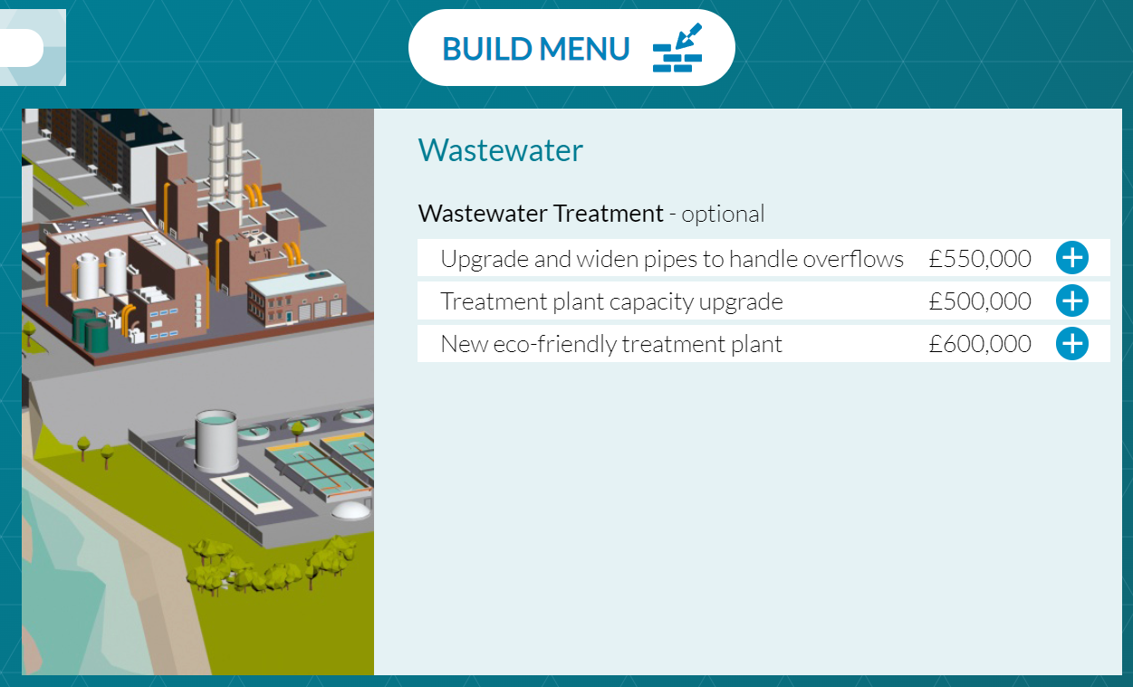
Pollution Control game – stage 3 build
Final stage: Build
Chose options from the build menu
Don’t rush into decisions – you can’t undo them later!
Don’t forget! You made promises earlier in the game… not meeting these can impact your score.

Slide 8




Pollution Control game – scores & prizes
CityZen is a game unlike any other…
It’s a learning game… where your game is probably different to your classmates…
different people to help = different outcomes!
Complete the game - get a certificate of achievement
Score over 1000 – get a Pollution Control Gold certificate!
Notes:
*Needs a disclaimer

Slide 9
Pollution Control game – scores & prizes
Prize info…
All the teams with either the highest, or the same top score in the 2025 challenge will be entered into a prize draw to win some fantastic prizes (3 teams):
A money-can’t-visit VIP tour to a local civil engineering office or project*
A £20 Waterstones vouchers for each team member
Notes:
*See the competition Terms and Conditions which can be found on the ice.org.uk/CityZen webpage.

Slide 10

Pollution Control game – debrief
At the end of the game…
We hope you enjoyed our challenge!
Perhaps it’s raised a few questions, like…
Did you have enough money to do everything you wanted?
Which promises did you break… and did you figure out why?
What decisions would you have made in retrospect?
What do you think you would enjoy about being a civil engineer?
Notes:
This slide is intended to facilitate a review of the game – to the share the game learnings and check understanding. You might ask students to put their hands up to answer one or all of the questions in turn, depending on the time you have available.]

Slide 11

The ICE CityZen Award
Want to flex your gaming muscles in the future with us?
ICE has a competition for full-time students studying at ages 16-18 which you could do!
It has great prizes – including a top award of £2,000 shared between students and school/college and a VIP visit to ICE’s London headquarters.
Find out more at ice.org.uk/CityZen
Notes:
[Students who have enjoyed playing CityZen Pollution Control may be interested in joining our competition for older students in the future. For more information please see the website or contact us at careers@ice.org.uk]

Slide 12
Have we built your interest in civil engineering?
Stay tuned for a quick low-down on the career’s top facts…

Slide 13

Could you be a civil engineer?
If you like designing or building, solving problems or improving lives then you’d enjoy a career in civil engineering.
Choosing the right subjects at school or college is important – maths is usually required and physics often too.
Notes:
To become a civil engineer you’ll need to choose the right subjects at school or college. It’s a good idea to check the requirements for any courses you’re interested in, as they can vary a lot.
Maths at A level or Scottish Highers is needed to get onto nearly all civil engineering degree courses. A good grade at GCSE or equivalent will help you secure an apprenticeship.
Physics at A level or Scottish Highers is also asked for by many universities.
Other useful subjects for civil engineering include Geography, Art and Design, Design Technology, Computing, English and some specialist courses such as the Design Engineer Construct! Programme which is offered in some schools.

Slide 14







Top career facts
The average (mean) starting salary is £28,000. Experienced civil engineers earn around £60,000 and at the top of the profession over £100,000.
It’s a career which has clear routes through study and qualification.
Studying to become an engineer can open doors to other careers: it keeps your options open!
The UK needs lots more civil engineers.
Civil engineers’ skills are in demand across the world.
Civil engineering regularly features in polls of the top happiest jobs!
Qualified engineers have a high status similar to doctors and lawyers.

Slide 15

How to become a civil engineer
There are loads of routes into civil engineering…
You could do A levels and then study at university.
You could get straight to work with an apprenticeship – combining study and hands-on experience.
OR you could do a vocational course… this might lead to an apprenticeship or university.
Notes:
Studying at university can give you a fast-track route to Chartered Engineer status and the top jobs in the profession. For more info see ice.org.uk/beacivilengineer
A vocational course (such as BTEC or HND) combines study with ‘hands on’ experience and can give you a fast-track to qualified Engineering Technician status. If you get taken on as an apprentice by a company you’ll get paid as well as be given time off each week to learn. It’s possible to progress from this role to become a Civil Engineer with enough job experience.
There are more ways to study and enter industry than ever before – including starting while still at school (foundation apprenticeships) and working and getting a degree at the same time (degree or graduate apprenticeships). For more info see ice.org.uk/apprentices

Slide 16


Explore and play in a future world of interactive civil engineering challenges.
ICE-futures.com
Final step 1 of 2…
Notes:
www.ice.org.uk

Slide 17

Free Virtual Work Experience https://bit.ly/ICE-virtworkexp
Final step 2 of 2…
Notes:
Virtual Work Experience is an online learning programme managed by award-winning education provider Springpod.
It is free and available to students aged 14-18 based in the UK.
Completing the programme gives a digital certificate and is a great addition to a CV or UCAS application.
https://bit.ly/ICE-virtworkexp

Slide 18

Thanks for taking part 🙂
Tell us what you thought for the chance to win a £10 Waterstones voucher: bit.ly/pollution_control_feedback
Notes:
https://bit.ly/feedback-pollution-challenge

